Slide 1
READLE
Team Details:
Tanisha 2310990982 (G-12)
Tanisha Bansal 2310990983 (G-12)
Sanskar Mishra 2310991353(G-12)
Submitted To : Mr. Aman Rajak
:
Chitkara University Institute of Engineering and Technology,
Chitkara University, Punjab

Slide 2
Table of Contents
Introduction
Problem Statement
Key Features
Code Snippets
Output
Project Github Link
References/Links used

Slide 3
Introduction
Readle is a user-friendly platform designed for book enthusiasts who want to discover, review, and explore a wide variety of books across multiple genres. It offers a seamless experience for both casual readers and passionate bibliophiles, allowing users to engage with the reading community, share opinions, and find recommendations. With its simple yet intuitive design, Readle caters to the needs of its users, providing easy navigation through different genres, as well as offering personalized features like book reviews, user management, and genre-specific browsing.

Slide 4
Problem Statement
You might be wondering what makes us so special compared to other websites. In the age of digital information overload, finding trustworthy book reviews and recommendations tailored to individual preferences can be overwhelming. Many book review platforms lack the necessary user-centric features to organize information effectively, making it difficult for users to find books that match their tastes. Additionally, users often struggle with the cluttered interfaces and limited genre-specific exploration options that many existing platforms provide. Therefore, there is a need for a simple, clean, and interactive book review website that caters to a broad audience by focusing on personalized book discovery, community-driven reviews, and genre-based categorization.

Slide 5
Key Features
Home Page: A welcoming interface showcasing featured books, popular reviews, and easy access to various sections of the site.
Admin Page: A management portal where administrators can oversee content, approve reviews, manage users, and ensure the smooth functioning of the website.
Login Page: A secure login system for users to create accounts, log in, and manage their profiles.
Add a Review: A dedicated page where users can submit their book reviews, share insights, and rate books based on their reading experience.
Genres Page: A categorized view of books, making it easier for users to browse books by their preferred genres. Each genre page lists books along with user reviews.

Slide 6
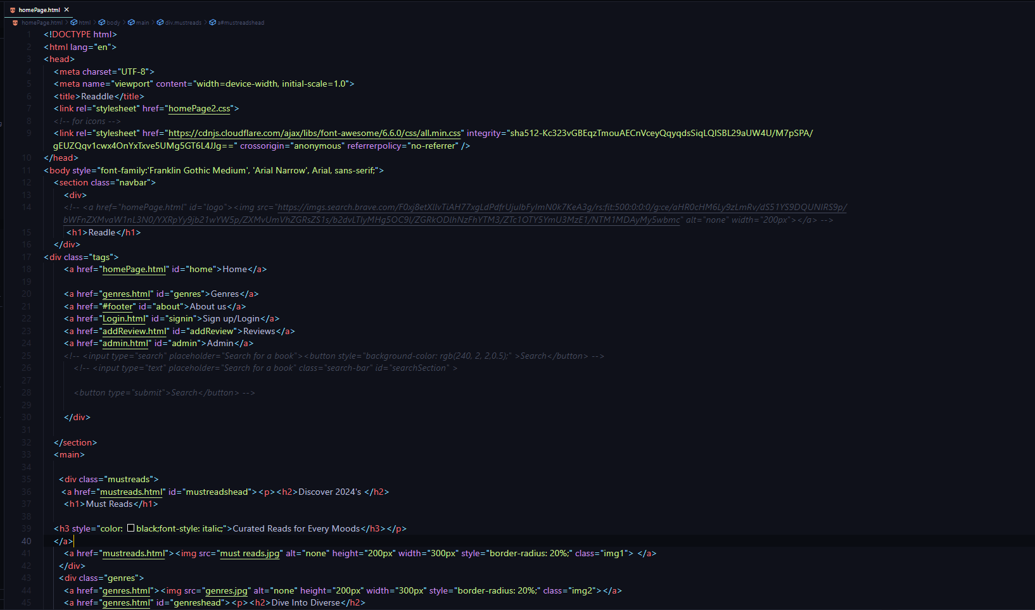
Code Snippet

Slide 7
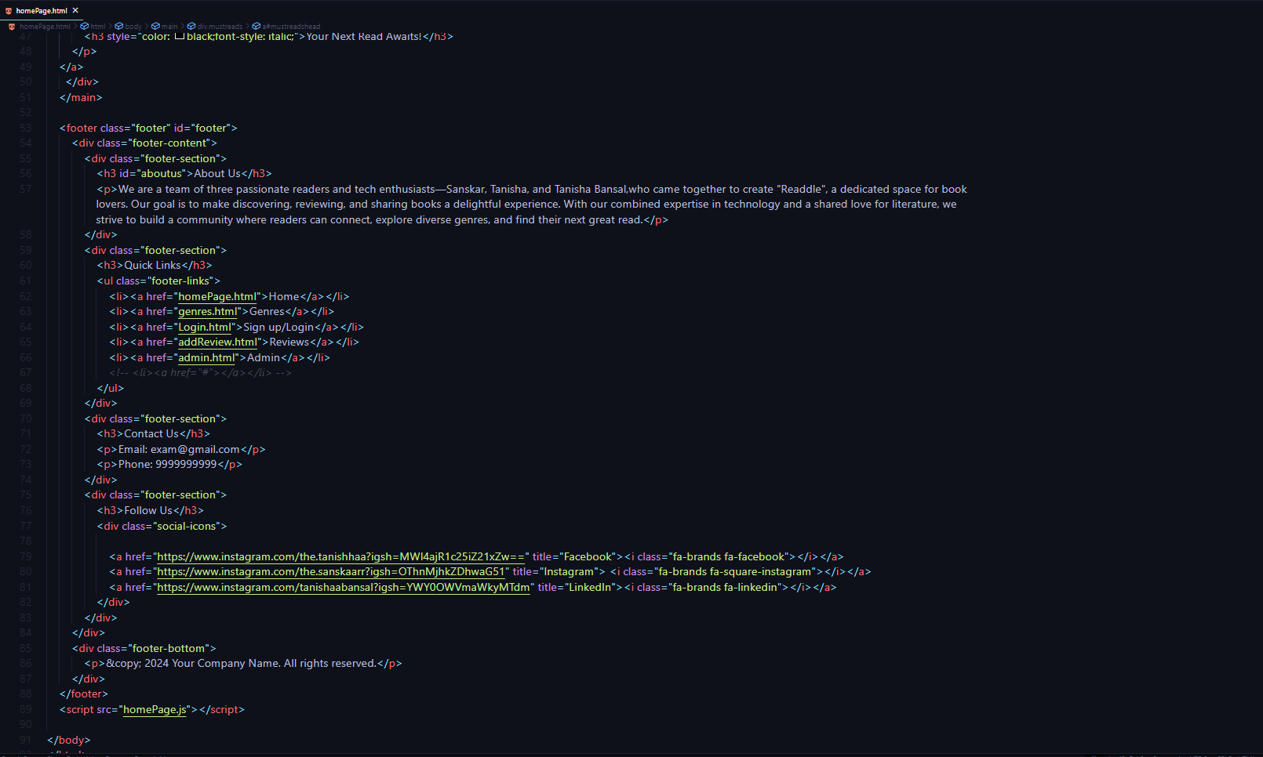
Code Snippet

Slide 8
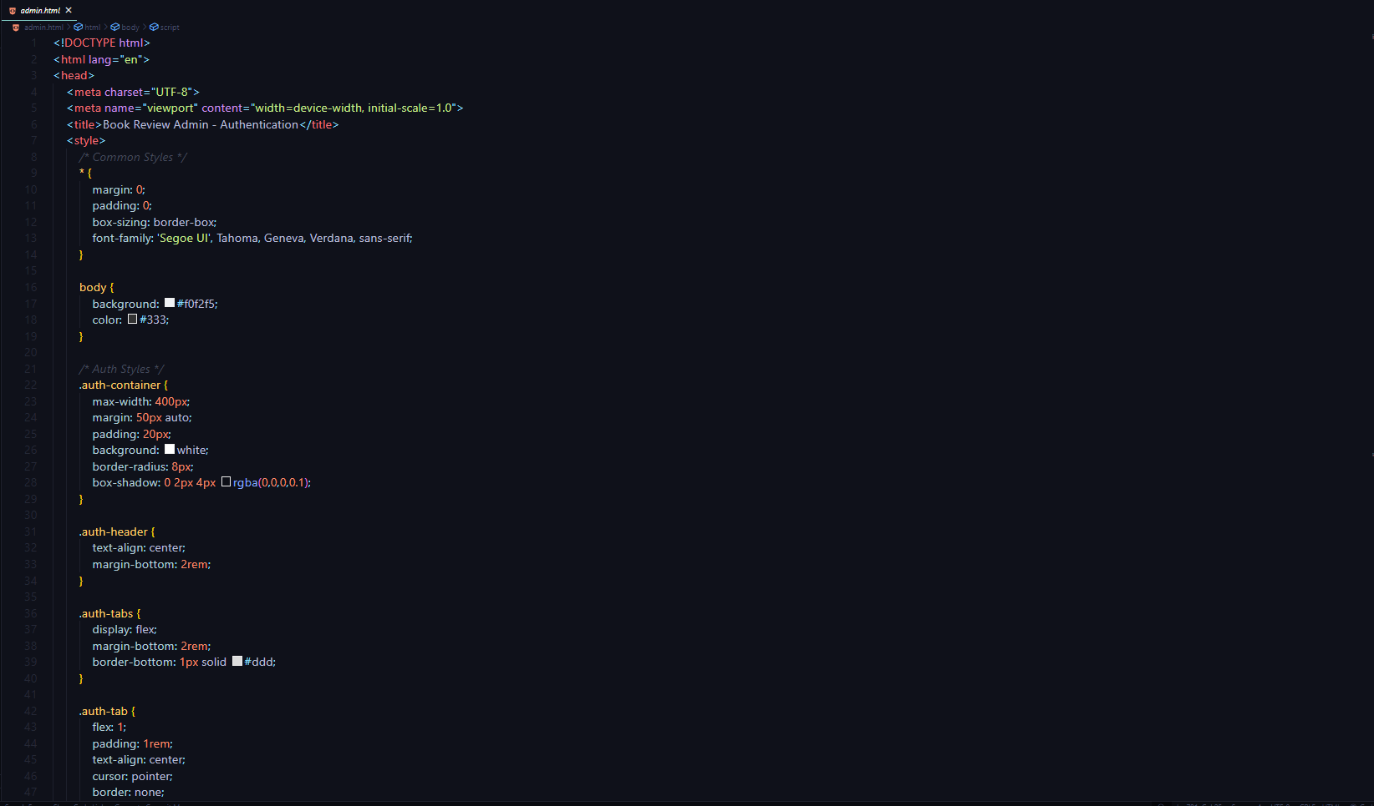
Code Snippet

Slide 9
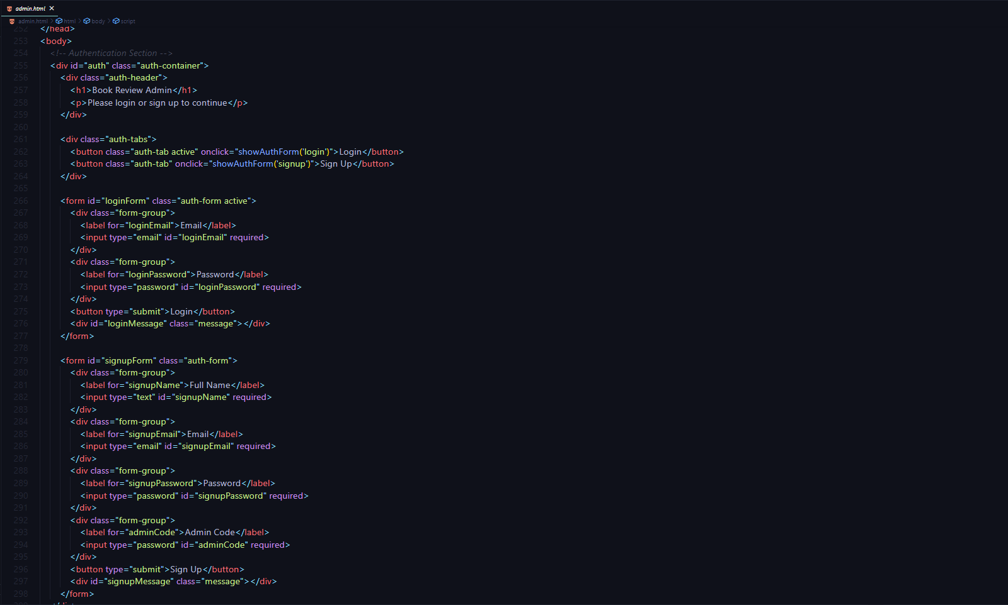
Code Snippet

Slide 10
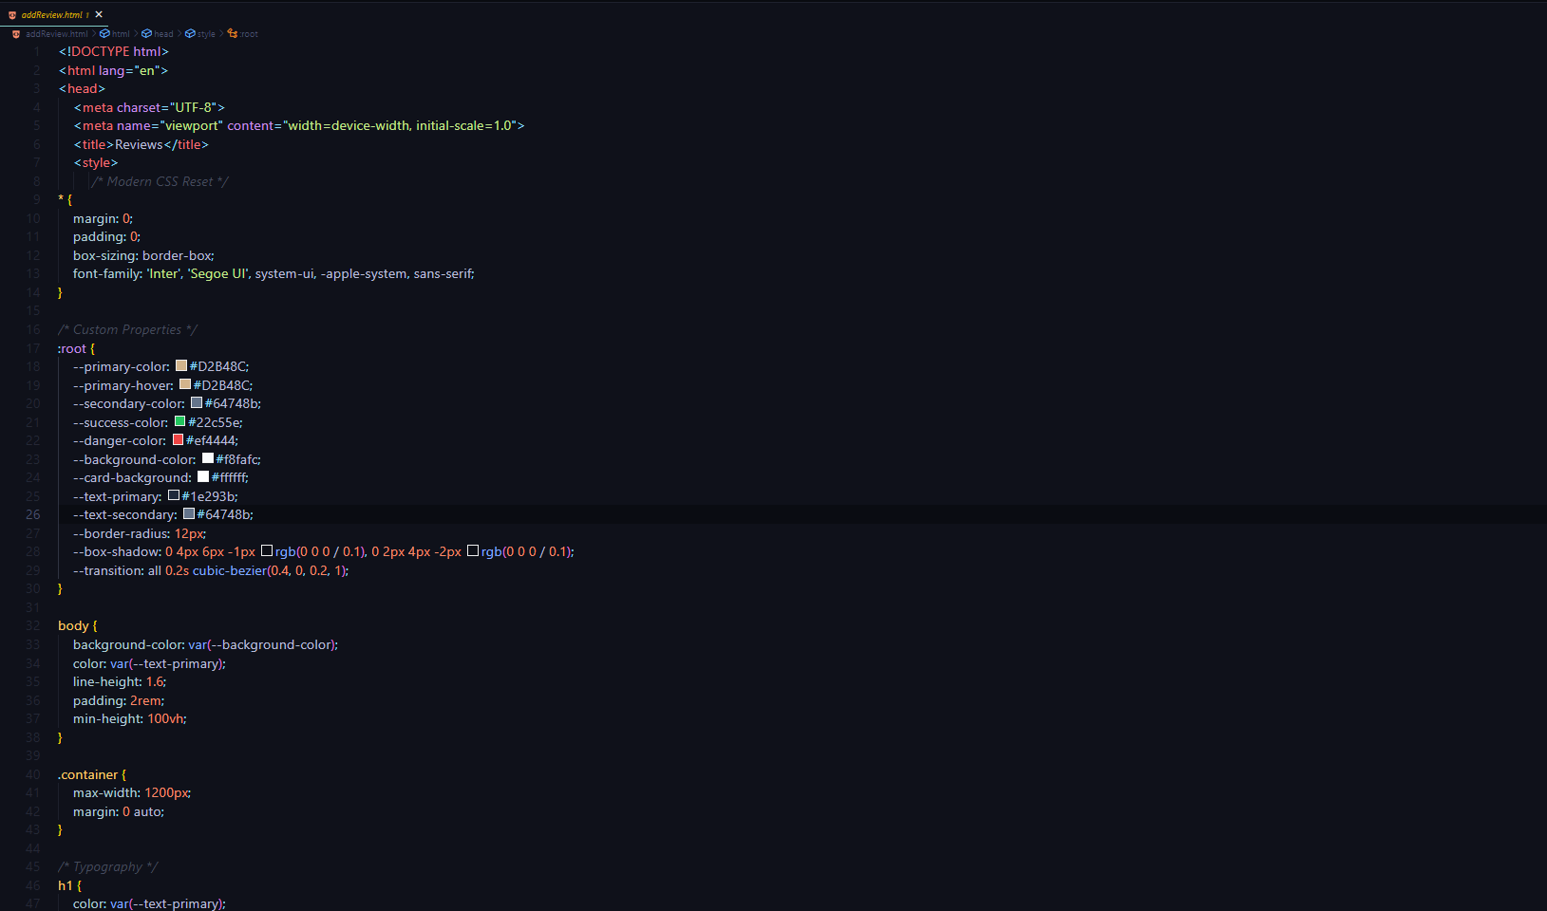
Code Snippet

Slide 11
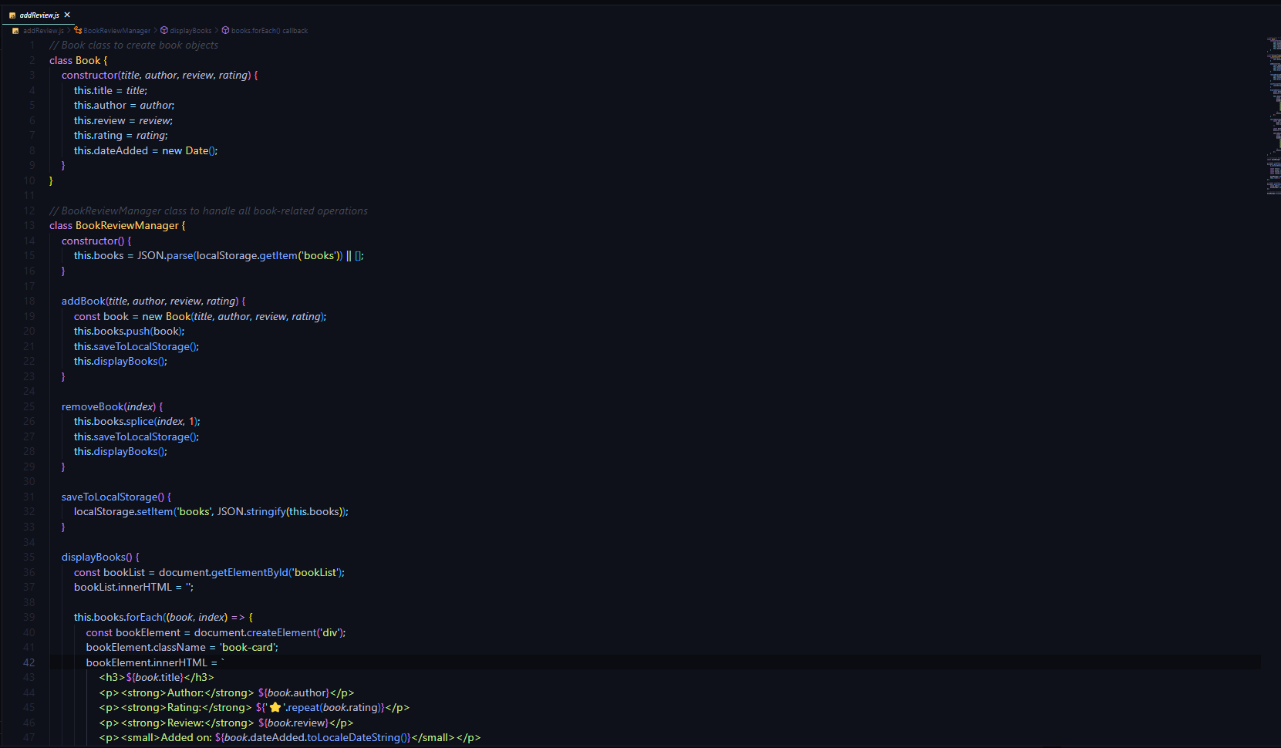
Code Snippet

Slide 12
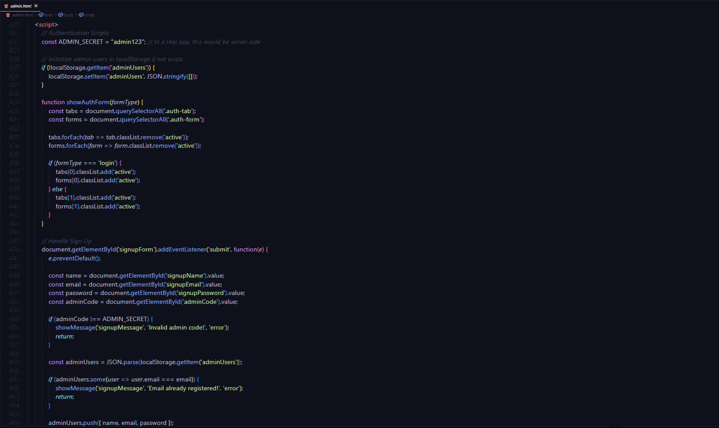
Code Snippet

Slide 13
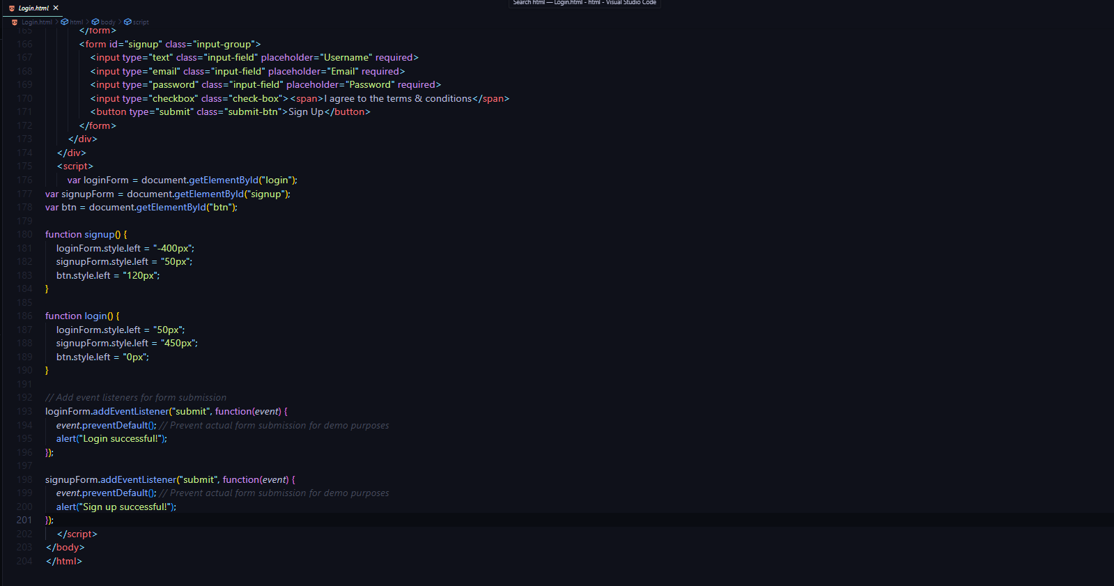
Code Snippet

Slide 14
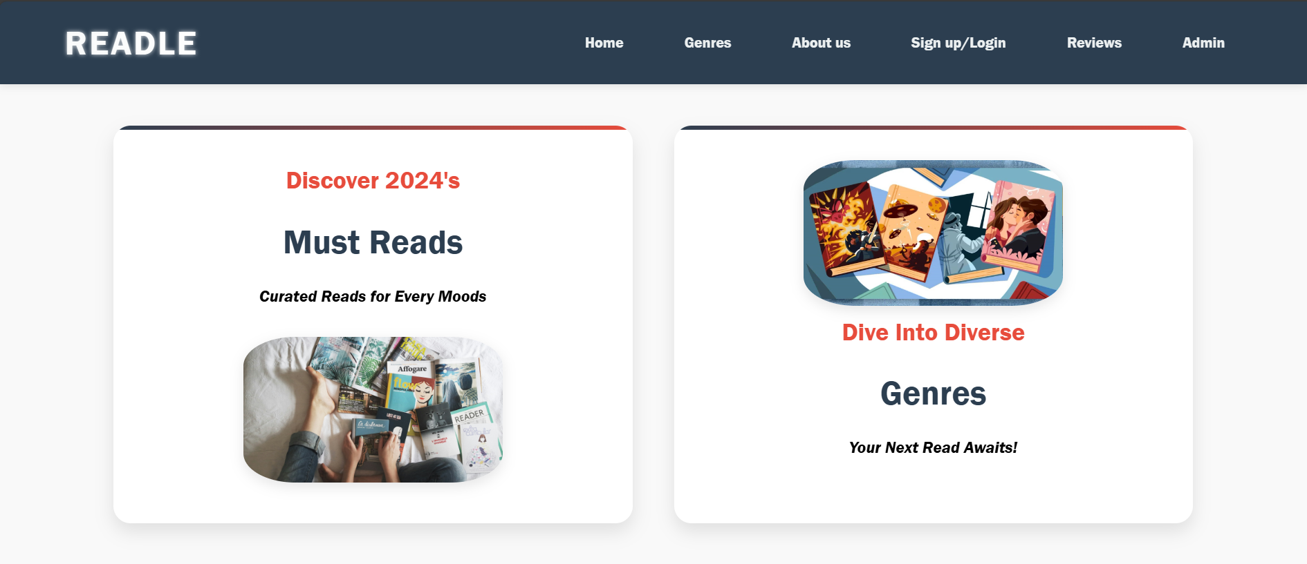
Output

Slide 15
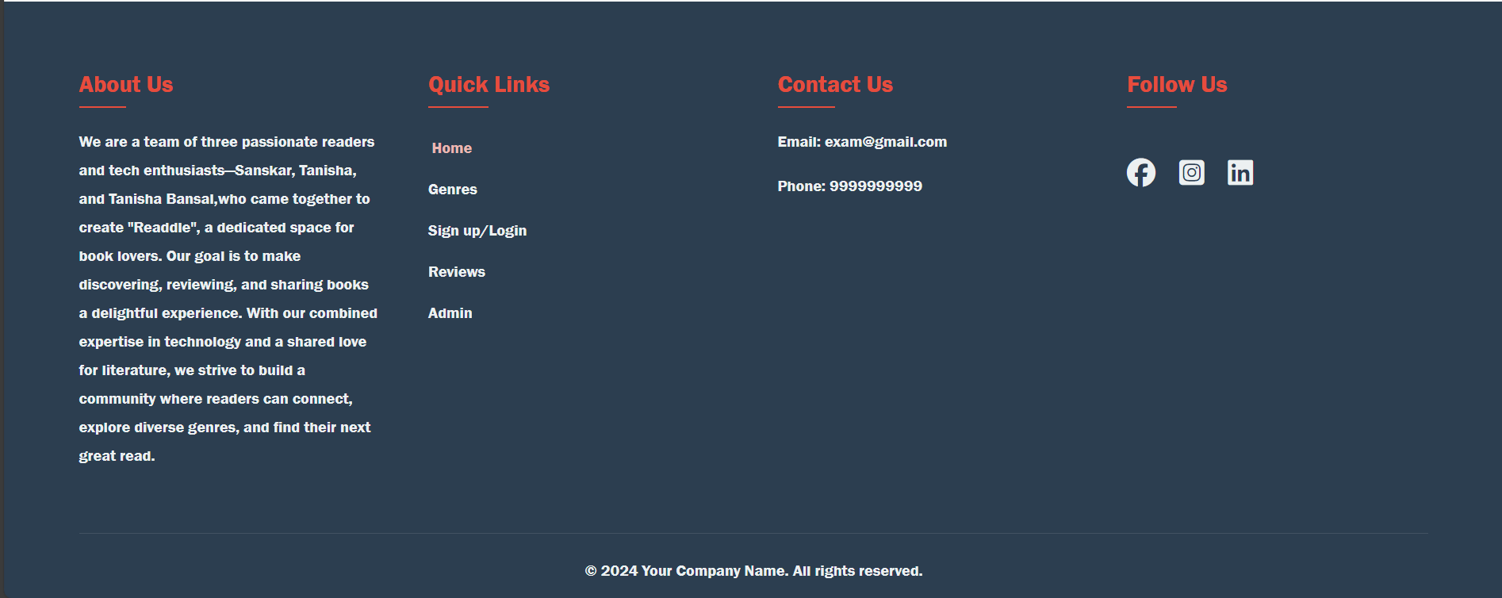
Output

Slide 16
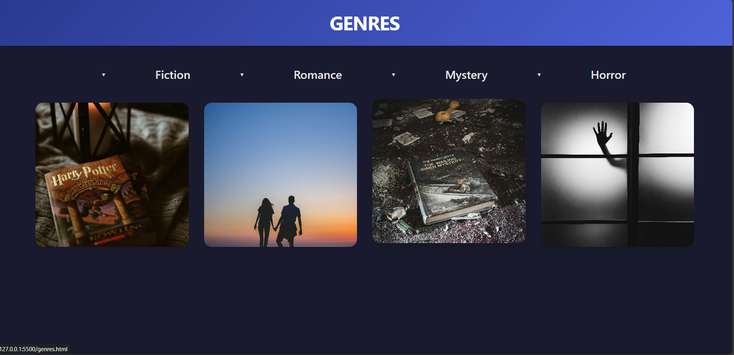
Output

Slide 17
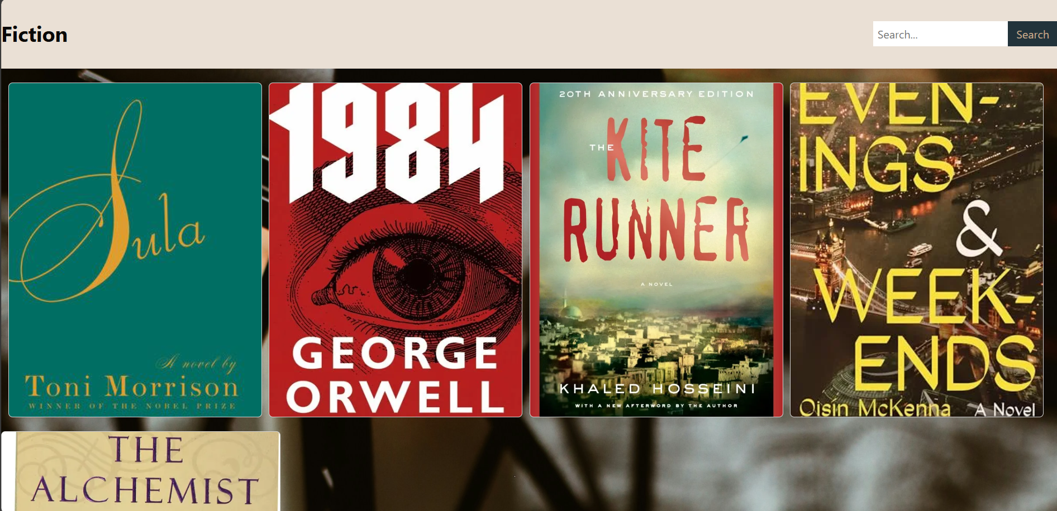
Output

Slide 18
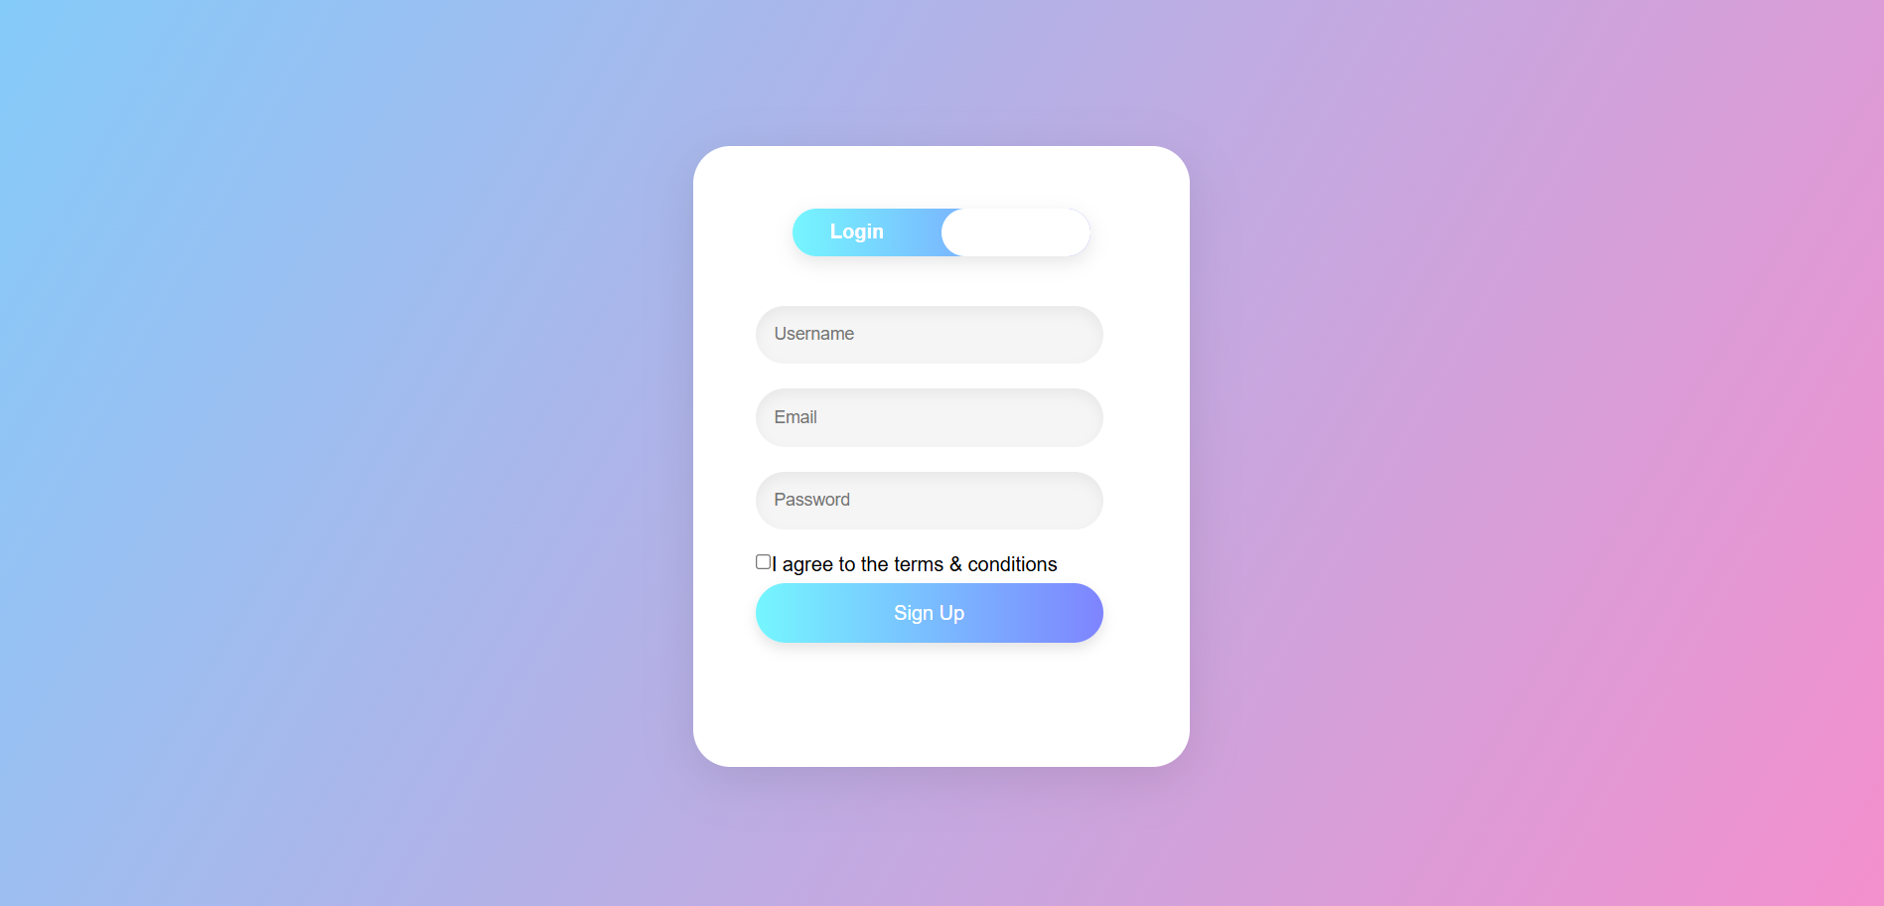
Output

Slide 19
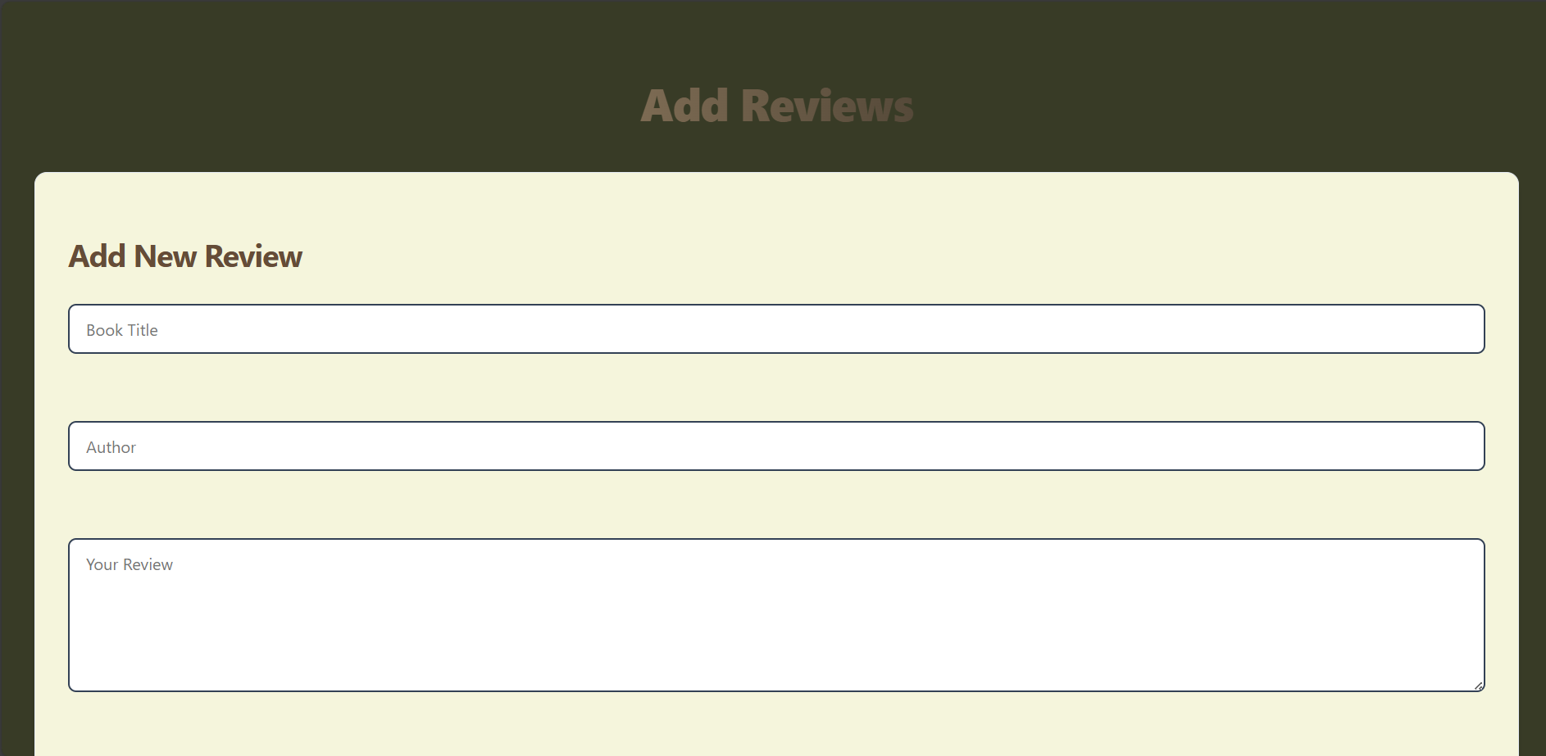
Output

Slide 20
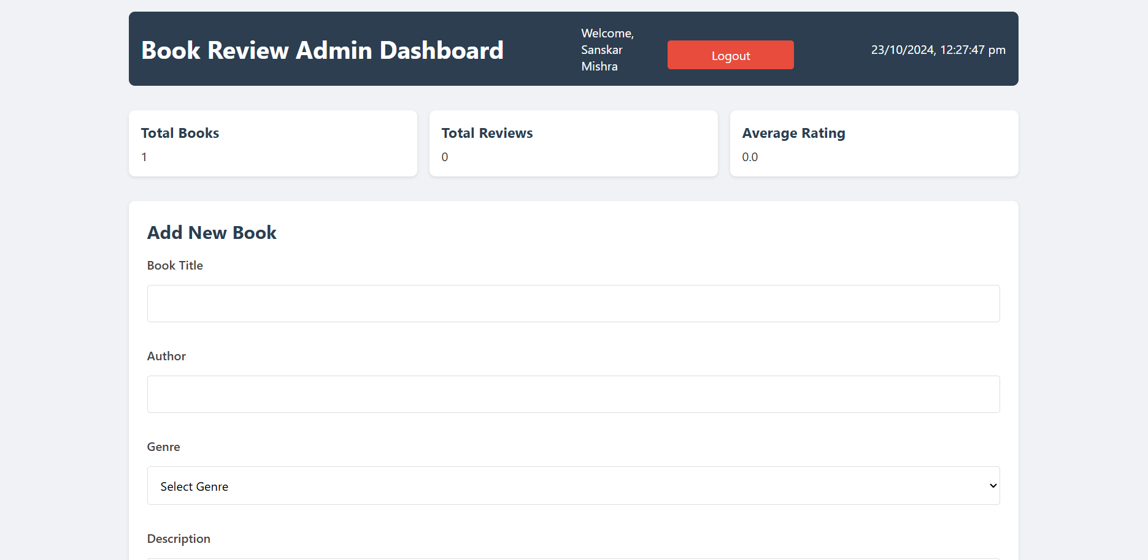
Output

Slide 21
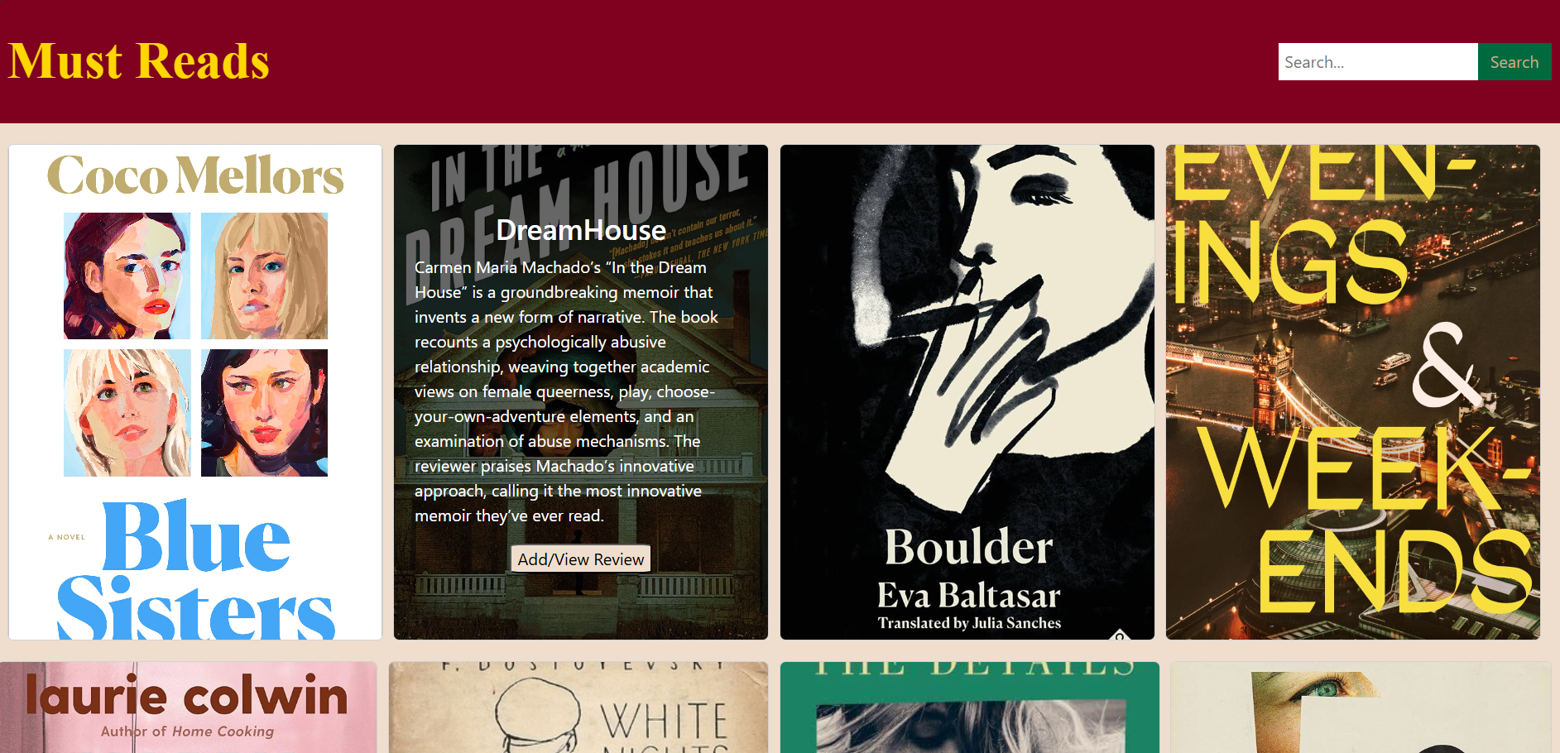
Output

Slide 22
Project Github Link
https://github.com/sanskar-1802/readle.git

Slide 23
Future Scope
In the future, Readle will expand by adding simple features like a “Most Reviewed” or “Top Rated” section to highlight popular books, a comment section for user discussions under each review, and a bookmark or "favorite" option for users to save books for easy access later. Social media integration and a newsletter subscription for book recommendations and updates will also boost user engagement. Additionally, introducing basic search filters, such as sorting books by genre or rating, will enhance the browsing experience.

Slide 24
References/Links used
https://www.goodreads.com/
https://www.amazon.in/kindle-dbs/storefront?storeType=browse&node=1634753031&ref_=pe_404181_172565231_pe_ebooks
https://www.youtube.com/

Slide 25


